Slide 1
3251 – Statistics for Data Science
Factors Affecting GPA
and
GPA Performance Between
Males and Females
Isaac Aktam

Slide 2
Objective
Regression
  Derive the linear regression models by means of backwards elimination that would describe GPA by fitting it on the features of
    Male Data
    Female Data
    Combined Data
Hypothesis Testing
  Determine what gender performs better, on average, in terms of GPA.
  Determine what gender has a more spread out GPA

Slide 3
Data Preparation
Survey 150 UTSC students. Drop 47 surveys due to erroneous completion. End up with 103 clean records where
  50 are for the Male Group
  53 are for the Female Group
Turn categorical variables into numerical by means of pd.get_dummies()
  Where Happiness is the categorical variable.

Slide 4
Survey Questions
What is your gender?
How many hours per week do you work?
How many hours per week do you spend on commuting to and from university?
If you are in a relationship, how many hours per week do you spend on your partner? • How many hours per week do you spend on extracurricular activities?
How many courses are you taking this semester?
How many lectures, in total, have you missed during this semester?
How many hours per week do you study?
What is your GPA?
One a scale from 1 to 5, specify your happiness level for this semester: 1 2 3 4 5

Slide 5
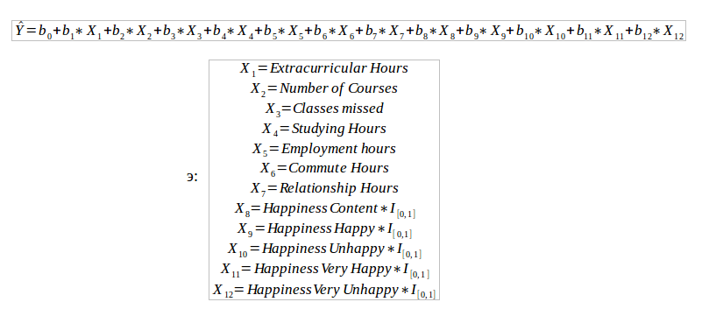
Analysis. Features.

Slide 6
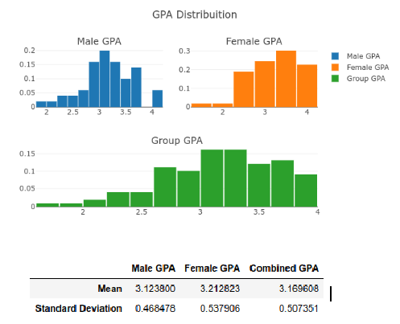
Analysis. Graph.

Slide 7
Analysis. Regression.
Combined. Run 6.
  Yhat = 2.6674-0.229*Classes missed+0.0074*Studying Hours+0.4249*Happiness_Content+0.5686*Happiness_Happy+0.37*Happiness_Unhappy+0.5647*Happiness_Very Happy+0.7392*Happiness_Very Unhappy.
  R-Squared = 0.228
  F-Test. P-value = 0.0003
Male
  Yhat = 2.6977-0.0201*Classes missed+0.0062*Studying Hours-0.0113*Employment Hours+0.4519*Happiness_Content+0.5869*Happiness_Happy+0.2843*Happiness_Unhappy+0.6201*Happiness_Very Happy+0.7544*Happiness_Very Unhappy
  R-Squared = 0.366
  F-Test. P-value = 0.00518
Female
  Yhat = 2.7078+0.3041*Happiness_Content+0.6076*Happiness_Happy+0.4884*Happiness_Unhappy+0.6055*Happiness_Very Happy+0.7022*Happiness_Very Unhappy
  R-squared = 0.07
  F-Test. P-Value = 0.474

Slide 8
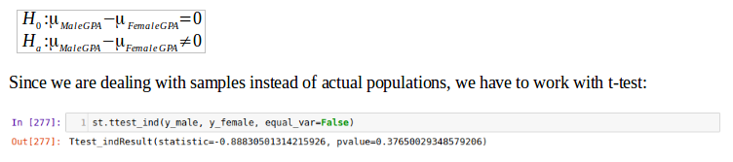
Analysis. Hypothesis testing.
Test of Difference of Means
Do not reject the null hypothesis and conclude that there does not exist a statistically significant difference between Mean Male GPA and Mean Female GPA.

Slide 9
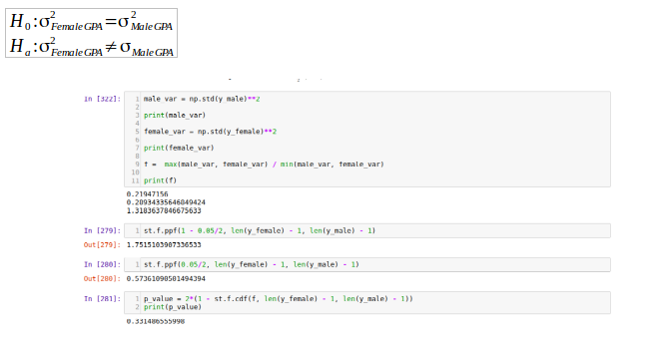
Analysis. Hypothesis Testing.
Test of difference of Male GPA Variance and Female GPA Variance
P-value = 0.33 > α = 0.05. Do no reject Null Hypotheis. There does not exist statistically significant difference in variance.

Slide 10
Conclusion.
There does not exist statistically significant difference in
  Mean Male GPA and Mean Female GPA
  Female GPA Variance and Male GPA Variance
For all of derived regression equations, coefficient of determination is quiet low. This means our regression equations explain/predict less than 40% of the actual data.
  Need more data
  Need more features
  Need better sampling surveying methods
  Try different regression techniques: Stepwise Regression, Forward Selection, and Best-Subset Regression

Slide 11
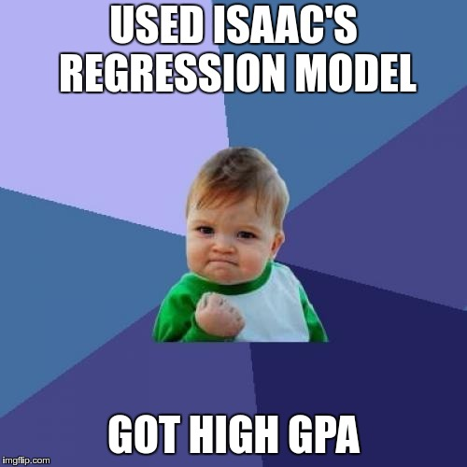
Thank You

